Slide 1
Office 365 development
Speaker name

Slide 2
Deep Dive into Search Scenarios in Office 365

Slide 3
Agenda
Overview
Search Building Blocks
Extending Search Center
Search APIs

Slide 5
1
Overview

Slide 6
SharePoint add-in building blocks
SharePoint add-ins
aspx
js
C#
Databases
png
CSS
master
Web Services
REST
SharePoint
CSOM
SharePoint API
Service Applications
List and libraries
Managed metadata
Search service
Workflow Service
BCS

Slide 7
Search Service Value
Single service application for locating documents, people, and data within SharePoint
Extend the OOB Search Center to create unique solutions with customized results, displays, and functionality
Use the Search API to incorporate search functionality in SharePoint apps

Slide 8
2
Search Building Blocks

Slide 9
Building Blocks
Managed Properties
Result Sources
Query Rules
Result Types
Search Navigation

Slide 10
Managed Properties
Mapped to Crawled Properties
Tenancy level
Site Collection level
Site Columns Become Managed Properties
Publishing and Multiple Lines prefixed with ows_r_<four-letter-code>
Managed Metadata prefixed with ows_taxId
All others prefixed with ows_q_<four-letter-code>

Slide 11
Managed Properties
Property | Description
Queryable | Managed Property can be used in property-based searches
Refinable | Managed Property can be used as a refiner
Retrievable | Managed Property can be returned in the results
Searchable | Includes the value of the Managed Property in the Search Index
Sortable | Managed Property can be used for sorting results
Type | The data type of the Managed Property
Safe | Can be returned to anonymous users
Alias | Friendly names
Multi-valued | Managed Property can have multiple values
Notes:
Tenant
SSA
Site Collection level

Slide 12
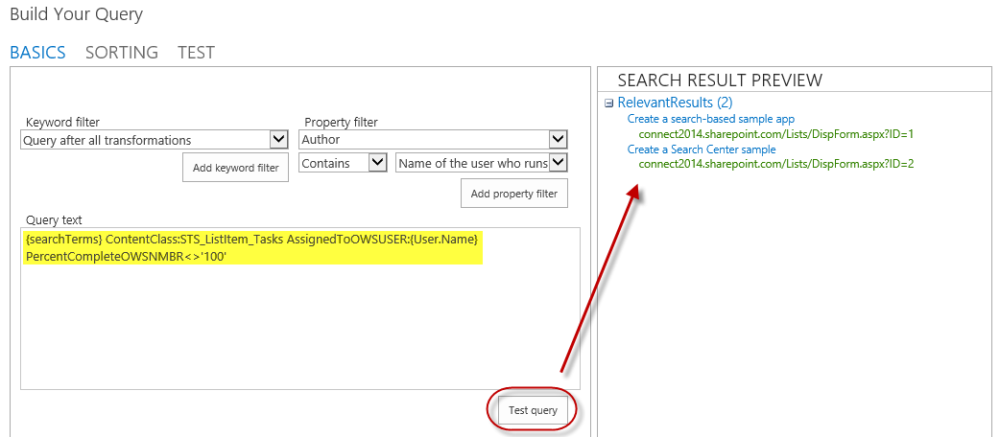
Result Sources
Select a Source
Local SharePoint Index
Remote SharePoint Index
OpenSearch
Exchange
Apply a Query Transformation
Defines a subset of the source

Slide 13
Query Rules
Applied to a given Result Source
Processed under specified conditions
Keyword match
Topic category match
Affects the query results
Alter the user’s query
Generate a Result Block

Slide 14
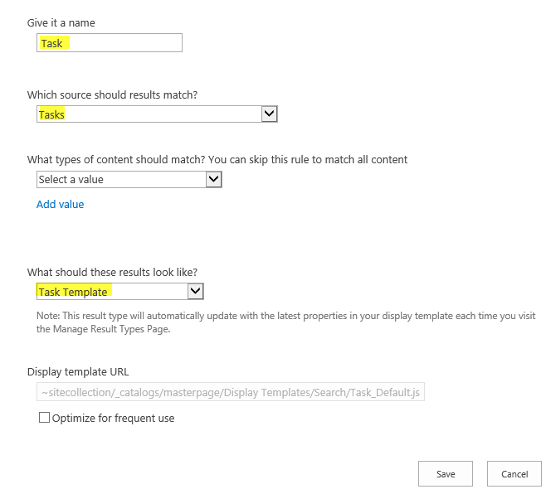
Result Types
Bound to a given Result Source
Defined by a rule
Associated with a template for display
Determines how Result Type appears
Created as an HTML file referencing Managed Properties

Slide 15
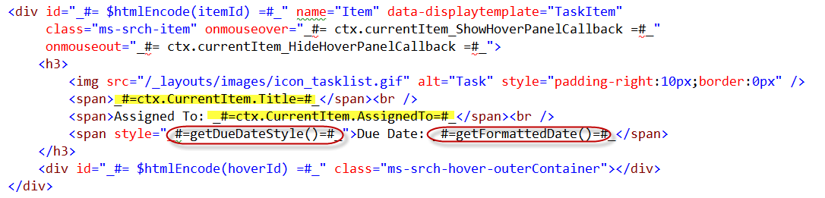
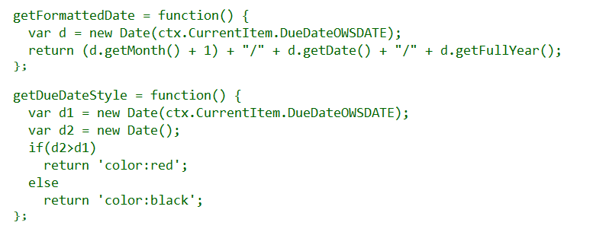
Display Templates

Slide 16
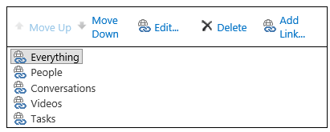
Search Navigation
Provides navigation across pages in Search Center

Slide 17
Export/Import Search Settings
Configuration export
SearchConfiguration.xml
Handles rules, sources, managed properties, etc.
Does not handle master pages, templates, and web parts
Configuration import
Import into site, site collection, tenancy
Programmatically import with app

Slide 18
3
Extending Search Center

Slide 19
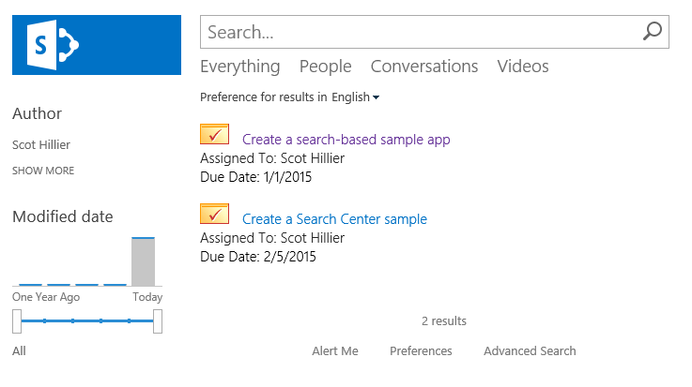
Custom Search Results
Use building blocks to create custom solutions in Search Center

Slide 20
Automating Search Center Modifications
Use App Installed Event to trigger modifications
Activating features
Uploading display templates
Manipulating web part properties
Include exported search configurations in apps
Add new “Search Configuration” to app

Slide 21
Activating Features
//Enable Publishing Infrastructure Feature
Guid id = new Guid("{F6924D36-2FA8-4f0b-B16D-06B7250180FA}");
var query1 = from f in clientContext.Site.Features
where f.DefinitionId == id
select f;
var features = clientContext.LoadQuery(query1);
clientContext.ExecuteQuery();
if (features.Count() == 0) {
clientContext.Site.Features.Add(id, false, FeatureDefinitionScope.None);
clientContext.ExecuteQuery();
}

Slide 22
Uploading Display Template
//Upload Display template
List gallery = clientContext.Site.RootWeb.Lists.GetByTitle(
MASTER_PAGE_GALLERY_TITLE);
Folder folder = clientContext.Site.RootWeb.GetFolderByServerRelativeUrl(
DISPLAY_TEMPLATE_FOLDER_URL);
clientContext.ExecuteQuery();
System.IO.FileStream fs = System.IO.File.Open(
HostingEnvironment.MapPath(DISPLAY_TEMPLATE_PATH),
System.IO.FileMode.Open, System.IO.FileAccess.Read);
FileCreationInformation fileCreationInfo = new FileCreationInformation();
fileCreationInfo.ContentStream = fs;
fileCreationInfo.Url = DISPLAY_TEMPLATE_NAME;
fileCreationInfo.Overwrite = true;
Microsoft.SharePoint.Client.File newFile = folder.Files.Add(fileCreationInfo);
clientContext.Load(newFile);
clientContext.ExecuteQuery();

Slide 23
Manipulating Web Parts
File resultsPage = webs.First().GetFileByServerRelativeUrl(SEARCH_PAGE_URL);
resultsPage.CheckOut(); clientContext.ExecuteQuery();
LimitedWebPartManager manager =
resultsPage.GetLimitedWebPartManager(PersonalizationScope.Shared);
var webPartDefs = manager.WebParts;
clientContext.Load(
webPartDefs,
parts => parts.Include(part => part.WebPart.Properties),
parts => parts.Include(part => part.WebPart.Title));
clientContext.ExecuteQuery();

Slide 24
Search Configuration
<SearchConfigurationSettings
xmlns:i="http://www.w3.org/2001/XMLSchema-instance"
xmlns="http://schemas.datacontract.org/2004/07/Microsoft.Office.Server.Search.Portability">
<SearchQueryConfigurationSettings>
<SearchQueryConfigurationSettings>
<BestBets xmlns:d4p1="http://www.microsoft.com/sharepoint/search/KnownTypes/2008/08" />
<DefaultSourceId>00000000-0000-0000-0000-000000000000</DefaultSourceId>
<DefaultSourceIdSet>true</DefaultSourceIdSet>
<DeployToParent>true</DeployToParent>
<DisableInheritanceOnImport>false</DisableInheritanceOnImport>
<QueryRuleGroups xmlns:d4p1="http://www.microsoft.com/sharepoint/search/..." />
<QueryRules xmlns:d4p1="http://www.microsoft.com/sharepoint/search/..." />
<ResultTypes xmlns:d4p1="http://schemas.datacontract.org/2004/07/...">
...

Slide 25
Demo
3 Creating Remote Event Receivers
Extending Search Center

Slide 26
4
Search APIs

Slide 27
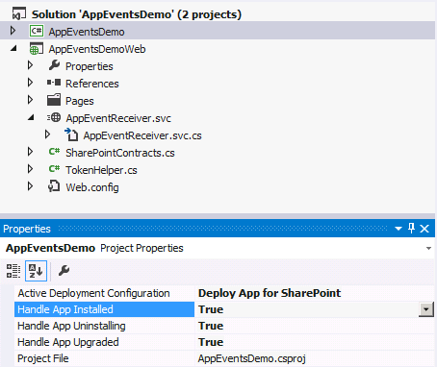
App Lifecycle Events
SharePoint app models support app events
App events for installation, upgrade and uninstall
Added to app project using property sheet
Implemented as a remote event receiver
Notes:
The installation, upgrade and uninstallation of an app raises events that developers can trap. These are surfaced as remote event receivers where the app calls out to a well known endpoint where the developer can do something upon these events.

Slide 28
REST Endpoint
Keywords
https://tenant/site/_api/search/query?querytext='{KQL Query}'
Selecting Properties
https://tenant/site/_api/search/query?querytext='test'&selectproperties='Title,Rank'
Sorting
https://tenant/site/_api/search/query?querytext='test'&sortlist='LastModifiedTime:descending'

Slide 29
JavaScript and REST
$.ajax(
{
url: "http://site/_api/search/" +
"query?querytext='{KQL Query}‘",
method: "GET",
headers: {
"accept": "application/json;odata=verbose",
},
success: onSuccess,
error: onError
}
);

Slide 30
JavaScript and CSOM
var context = SP.ClientContext.get_current();
var keywordQuery =
new Microsoft.SharePoint.Client.Search.Query.KeywordQuery(context);
keywordQuery.set_queryText("sharepoint");
var searchExecutor =
new Microsoft.SharePoint.Client.Search.Query.SearchExecutor(context);
results = searchExecutor.executeQuery(keywordQuery);
context.executeQueryAsync(onGetEventsSuccess, onGetEventsFail);

Slide 31
C# and REST
var spContext = SharePointContextProvider.Current.GetSharePointContext(HttpContext);
string accessToken = spContext.UserAccessTokenForSPAppWeb;
string url = "http://site/_api/search/query?querytext='sharepoint'";
HttpClient client = new HttpClient();
HttpRequestMessage request = new HttpRequestMessage(HttpMethod.Get, url);
request.Headers.Accept.Add(new MediaTypeWithQualityHeaderValue("application/xml"));
request.Headers.Authorization = new AuthenticationHeaderValue("Bearer", accessToken);
HttpResponseMessage response = await client.SendAsync(request);
string responseString = await response.Content.ReadAsStringAsync();

Slide 32
C# and CSOM
var spContext = SharePointContextProvider.Current.GetSharePointContext(Context);
using (var cctx = spContext.CreateUserClientContextForSPHost())
{
KeywordQuery query = new KeywordQuery(cctx);
query.QueryText = "{KQL}";
SearchExecutor executor = new SearchExecutor(cctx);
ClientResult<ResultTableCollection> results = executor.ExecuteQuery(query);
cctx.ExecuteQuery();
}

Slide 33
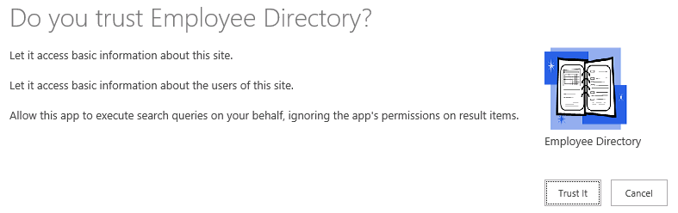
App Permissions
<AppPermissionRequest Scope=http://sharepoint/search
Right="QueryAsUserIgnoreAppPrincipal" />

Slide 34
Demo
4 Creating, Updating & Deleting Data with REST Services
Search APIs

Slide 35
Summary
Overview
Search Building Blocks
Extending Search Center
Search APIs

Slide 36
Further reading…
SharePoint Code Samples
SharePoint Training videos and hands on labs
SharePoint documentation
SharePoint Patterns and Practices (PnP)

Slide 37
Engage

